Slide 1

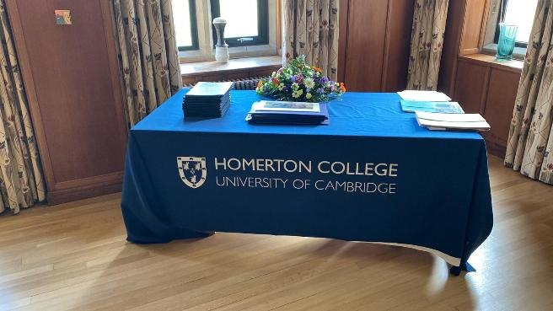






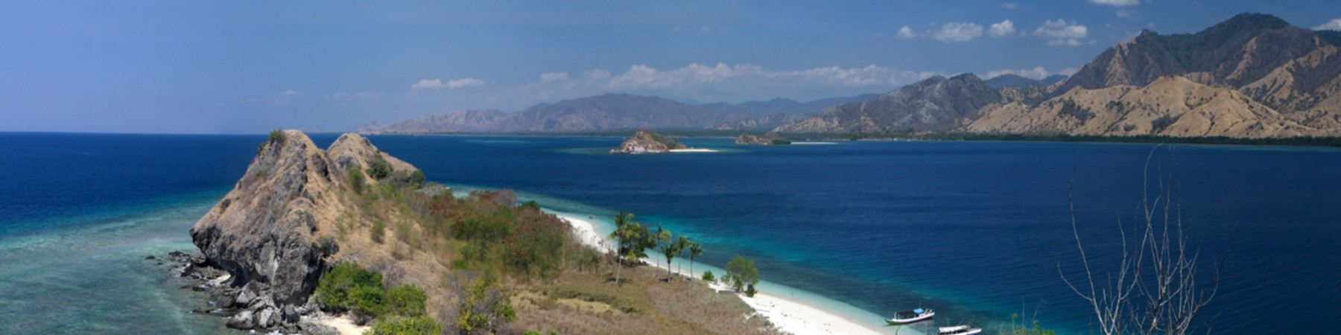
East Java Regional House of Representatives
Overview
LCT is proud to partner with Homerton College, Cambridge, to deliver ‘Professional Development in Educational Equity as a Civil and Human Right’ to delegates from the East Java House of Representatives (Unicameral Legislature Indonesia). Held in Cambridge the programme equipped delegates with a comprehensive understanding of the legal and administrative frameworks essential to policymaking.
CASE STUDY
About LCT
LCT International is a British Accreditation Council-accredited provider of CPD-certified executive education, with over 30 years’ experience delivering transformational learning for public and corporate leaders worldwide. We’re proud to have recently achieved Provider of Training Excellence Status.
Challenges
Effective leadership in education policy
To enhance strategic capability in driving impactful educational reforms.
Educational equity as a civil and human
rights
To understand and apply a rights-based approach to inclusive education.
International best practices in governance and policy To explore proven global models that inform better local policy decisions.
Simultaneous interpretation services
To ensure full engagement and comprehension for all participants.
Training
Approach
Interactive Learning
Case Studies, Group exercises, real - world application to ensure practical engagement
Leadership & Stakeholder management Focus
Strengthening Decision-Making, Team Leadership and Collaboration
Practical Application
Hands-on experience with tasks and strategies

Slide 2

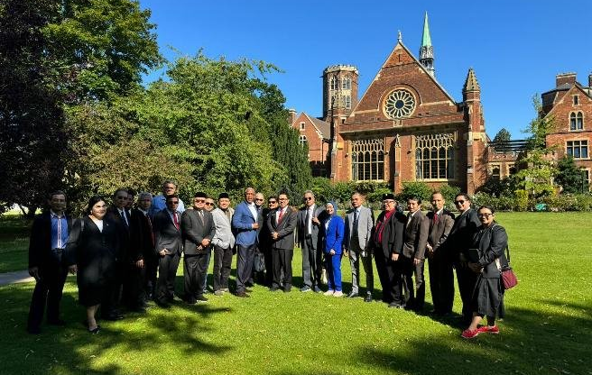



Focus On Quality
LCT International is accredited by the British Accreditation Council. This accreditation means that LCT International has chosen to seek external accreditation and receive a review on its processes to demonstrate that it is a high- quality organisation.
In order to achieve BAC accreditation, the institution has to demonstrate that it meets BAC’s rigorous standards in four inspection areas:
Course Outcomes
Strengthened Governance Awareness
Delegates gained a deeper understanding of governance structures, civil rights, and their direct influence on equitable education policy.
Enhanced Framework Evaluation
Members of East Java Regional House were equipped with practical tools to critically assess and strengthen governance models within their regional institutions.
Improved Legal Insight
Participants developed a stronger awareness of legal frameworks that underpin public service and drive innovation in education policy.
Advanced Ethical Leadership Competence
The East Java Regional House of Representatives explored ethical leadership principles to support more inclusive and transparent policymaking.
Greater Global Policy Adaptability
Developed the ability to adapt international best practices to fit the unique cultural and administrative context of East Java.
Management
Teaching
Welfare
Facilities
Client Satisfaction
At LCT International, client satisfaction remains central to everything we do.
The programme was met with extremely positive feedback from the East Java delegation, who praised the relevance of the content, the expertise of the trainers, and the overall quality of the learning experience
“The trainers offered valuable real-world insight, helping us view policy challenges through a global, inclusive lens.”
— Senior Member, East Java House of Representatives.
“The sessions were well-paced, practical, and highly engaging. We came away with tools we can apply directly in our constituencies.”
— Committee Participant
www.lct.co.uk
info@lct.co.uk
+44(0)2045423230

